Slide 1


FULL STACK WEB DEVELOPMENT WITH DJANGO
Lecture 25

Slide 2

Today’s Agenda
Developing Our Django App
Getting User Input
Handling HTML Forms

Slide 3
Information About Submitted Data
Beyond basic metadata about the request, the HttpRequest object has two attributes that contain information submitted by the user: request.GET and request.POST.
Both of these are dictionary-like objects that give us access to GET and POST data.
POST data generally is submitted from an HTML <form>, while GET data can come from a <form> or the query string in the page’s URL.

Slide 4
Form Handling In Django
As we know all the user input in HTML is always handled using HTML forms.
Django provides us 2 ways to deal with forms in our Django app:
1. By writing <form> tag
2. By using Django's form library called django.forms
Initially we will use the first approach and build a sample app , and then we will use the Django forms library

Slide 5
Form Handling In Django
Continuing the ongoing example of books, let’s create an app that lets users search our book database by subject.
Generally, there are two parts to developing a form:
the HTML user interface and
the backend code that processes the submitted data.
Let us begin the app by performing the usual initial steps as listed in the next slide

Slide 6
Performing Initial Steps
Load the virtual environment in VS CODE
Create a django project called formdemoproj1 by using the command:
django-admin startproject formdemoproj1
This will create the outer project folder called formdemoproj1 and inner app folder also by the same name

Slide 7
Performing Initial Steps
Now go to the outer project folder formdemoproj1 and create an app called formdemoapp1 by using the command:
django-admin startapp formdemoapp1
Now create a folder called templates in the formdemoapp1 followed by an inner folder called formdemoapp1

Slide 8
Performing Initial Steps
Inside templates/formdemoapp1 create 2 HTML files called search_form.html,search_result.html
Finally update settings.py so that it contains the name of our app

Slide 9
Performing Initial Steps
Code:
INSTALLED_APPS = [
'django.contrib.admin',
'django.contrib.auth',
'django.contrib.contenttypes',
'django.contrib.sessions',
'django.contrib.messages',
'django.contrib.staticfiles',
‘formdemoapp1',
]

Slide 10
Performing Initial Steps
Now create a Book Model to represent Book table in the database.
Following is the structure we want for our Book table
Column Name | Data Type | Description
Book_id | Number | To store unique book id
Book_name | Varchar2 | To store name of the book
Book_price | Number | To store price of the book
Subject | Varchar2 | To store subject name of the book
Pub_date | Date | To store date of publishing

Slide 11
Performing Initial Steps
Open the models.py file in our formdemoapp1 folder and add the following model code:
formdemoapp1/models.py
from django.db import models
class Book(models.Model):
book_id=models.IntegerField()
book_name=models.TextField()
book_price=models.FloatField()
subject=models.CharField(max_length=30)
pub_date=models.DateField()

Slide 12
Performing Initial Steps
Now that we’ve created the Book model, we should now sync it with the database using migrations.
Make sure the virtual environment is running and then change into the formdemoproj1 directory.
From the VS command prompt, run:
python manage.py makemigrations formdemoapp1
Hit enter, and then run:
python manage.py migrate formdemoapp1

Slide 13
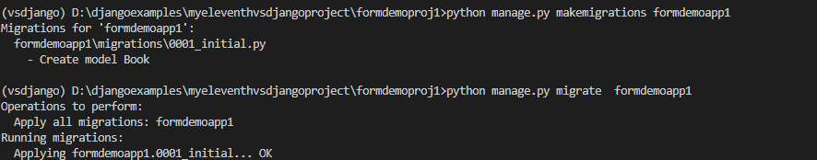
Performing Initial Steps

Slide 14
Performing Initial Steps
After we have synced the model with the database , our next task is to add some book objects to the database using Django’s database API
This can be done either by using SQLite browser or Django shell.
Using either approach add the data shown in the next slide in the formdemoapp1_Book table in the database.

Slide 15
Performing Initial Steps
book_id | book_name | book_price | subject | pub_date
101 | Let Us C | 250.0 | C | 2001-01-15
102 | Mastering Python | 450.0 | Python | 2014-10-21
103 | Python Projects | 350.0 | Python | 2016-04-09
104 | Let Us C++ | 350.0 | C++ | 2006-04-19
105 | Mastering C | 340.0 | C | 2014-12-22
106 | Learning Java | 650.0 | Java | 2018-11-19

Slide 16
Performing Initial Steps
Now that we have added the books to the database we must design an HTML form so that user can type the subject name in it for searching books.
We will also have to tie-up this form to a view function for rendering it to the user.

Slide 17
Performing Initial Steps
To create the HTML form go to the html file search_form.html and write the following simple HTML code in it:
<html>
<head>
<title>Search</title>
</head>
<body>
<form action="/search/" method="get">
Enter Subject Name:<input type="text" name="subject"><br>
<input type="submit" value="Search">
</form>
</body>
</html>

Slide 18
Performing Initial Steps
Now to connect the search_form.html to a view function do the following:
In the views.py , create a function called searchFormView()
Write the code shown in next slide in it.

Slide 19
Performing Initial Steps
def showSearchPage(request):
return render(request, 'formdemoapp1/search_form.html')
This code simply renders search_form.html as soon as the user types /search_books/ in the url

Slide 20
Performing Initial Steps
Now we need to create a URL conf so Django can find our new view.
To do this follow the below mentioned steps
Open the urls.py in the formdemoapp1 folder
Add the following URL pattern to this new urls.py:
from django.urls import path
from . import views
urlpatterns = [
path('search_books/',views.showSearchPage),
]

Slide 21
Performing Initial Steps
In the VS Code open the file called urls.py in the formdemoproj1 folder and update the code in it as shown below in green.
Code (formdemoproj1/urls.py):
from django.contrib import admin
from django.urls import path,include
urlpatterns = [
path('admin/', admin.site.urls),
path('',include('formdemoapp1.urls'))
]

Slide 22
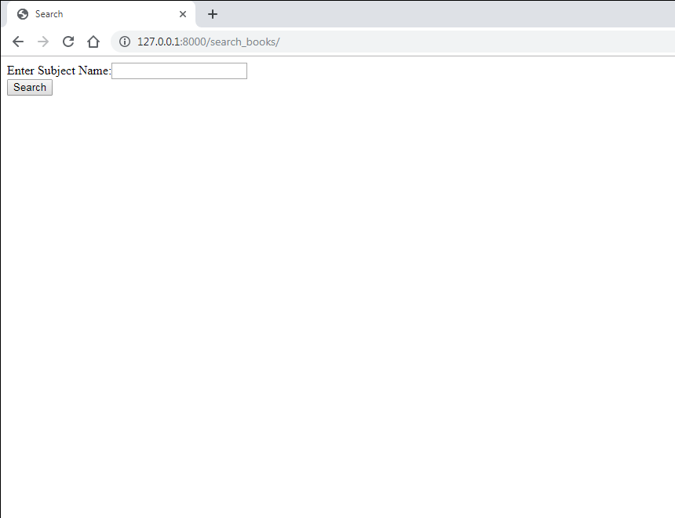
Performing Initial Steps
If we run the app and type the url http://127.0.0.1:8000/search_books then we will get the following output

Slide 23
Performing Initial Steps
Now to make the search button functional we must associate it with a view function .
This function will do the following:
Check whether the key subject is having a value or not
If it is present then using Django’s Database API retrieve all the books of the given subject
If it is not present then display the message Please submit a search term.

Slide 24
Performing Initial Steps
def showResultPage(request):
if request.GET['subject']!="":
subj = request.GET['subject']
books = Book.objects.filter(subject=subj)
return render(request, 'formdemoapp1/search_result.html',
{'books': books, 'query': subj})
else:
return HttpResponse('Please submit a search term.')

Slide 25
Performing Initial Steps
Now we will have to code search_result.html page in templates directory.
This page will be loaded when the user clicks the search button and shows the names of all the books belonging to that subject entered.

Slide 26
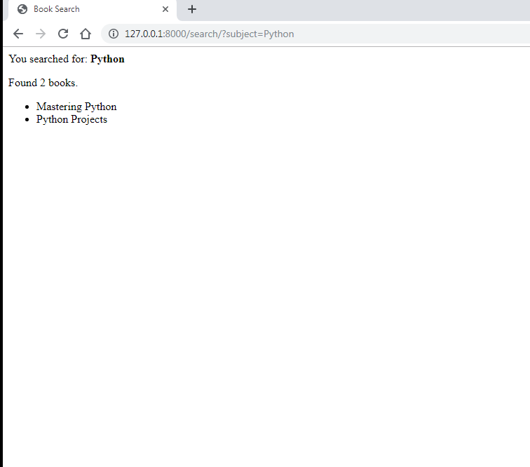
Performing Initial Steps
Following is the desired output of search_result.html assuming that the user has entered Python in the search box

Slide 27
Performing Initial Steps
Following is the code of search_result.html:
<html>
<head>
<title>Book Search</title>
</head>
<body>
<p>You searched for: <strong>{{ query }}</strong></p>
{% if books %}
<p>Found {{ books|length }} book{{ books|pluralize }}.</p>
<ul>
{% for book in books %}
<li>{{ book.book_name }}</li>
{% endfor %}
</ul>
{% else %}
<p>No books matched your search criteria.</p>
{% endif %}
</body>
</html>

Slide 28
Performing Initial Steps
Finally before running the app we must update the urls.py file in the formdemoapp1 folder and make an entry for the searchView() function
from django.urls import path
from . import views
urlpatterns = [
path('search_books/',views.searchFormView,name='searchform'),
path('search/',views.searchView,name=search'),
]

Slide 29
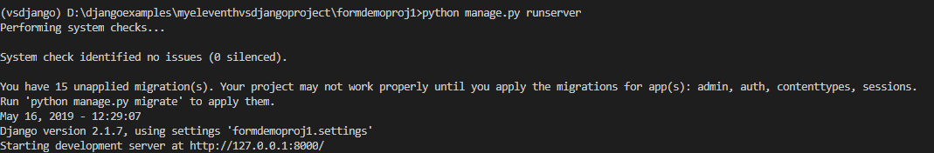
Running The Server
To run our new formdemoapp1 , go to the folder formdemoproj1 by using cd command and type the runserver command in VS Code terminal
cd formdemoproj1
python manage.py runserver.
The server runs and we’ll see output like the following output in the terminal window:

Slide 30
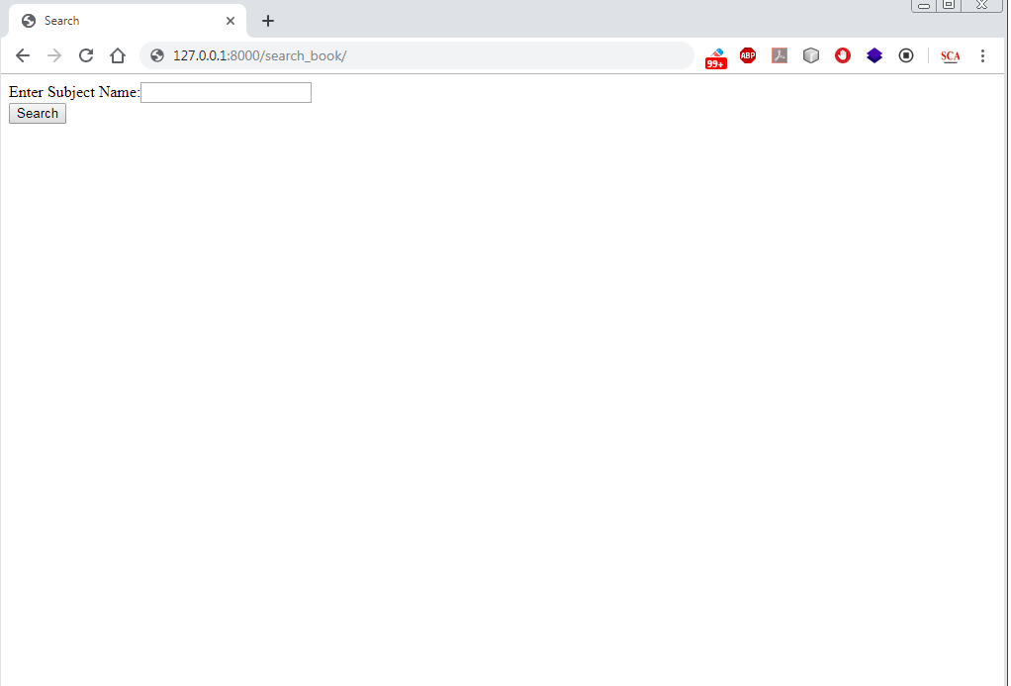
Opening The Page
Now we have to open the search page , so we type the url
http://127.0.0.1:8000/search_books which will open the search
page

Slide 31
Opening The Page
Finally when we will enter subject name as Python and click the search
button , it will open the search_result.html page , which will show the
following output

Slide 32
Exercise 1
Although our previous code worked but still there are some problems in it
First, our showResultPage() view’s handling of an empty query is poor!
We’re just displaying a "Please submit a search term." message, requiring the user to hit the browser’s back button. This is very unprofessional
It would be much better to redisplay the form, with an error above it, so that the user can try again immediately.

Slide 33
Solution
def showResultPage(request):
if request.GET['subject']!="":
subj = request.GET['subject']
books = Book.objects.filter(subject__=subj)
return render(request, 'formdemoapp1/search_result.html',
{'books': books, 'query': subj})
else:
return render(request, 'formdemoapp1/search_form.html', {'error': True})

Slide 34
Solution
Here, we’ve improved showResultPage() to render the search_form.html template again, if the query is empty.
And because we need to display an error message in that template, we pass a template variable.
Now we can edit search_form.html to check for the error variable:

Slide 35
Solution
html>
<head>
<title>Search</title>
</head>
<body>
{% if error %}
<p style="color: red;">Please submit a search term.</p>
{% endif %}
<form action="/search/" method="get">
Enter Subject Name:<input type="text" name="subject"><br>
<input type="submit" value="Search">
</form>
</body>
</html>

Slide 36
Exercise 2
With this change in place, it’s a better application, but it now another question:
Do we need a separate showSearchPage() view function ?
If you closely observe then we can drop the showSearchPage() view function and redefine the showResultPage() view function in such a way that it hides the error message when somebody visits /search/ with no GET parameters:

Slide 37
Solution
def searchView(request):
error = False
if 'subject' in request.GET:
subj = request.GET['subject']
if not subj:
error = True
else:
books = Book.objects.filter(subject__=subj)
return render(request, 'formdemoapp1/search_result.html',
{'books': books, 'query': subj})
return render(request, 'formdemoapp1/search_form.html',
{'error': error})

Slide 38
Exercise 3
Modify the previous app , so that if the subject name entered by the user is more than 10 characters in length then your form displays the error message “Please enter at the most 10 characters”
Also make sure that if the input field is left blank the error message should be “Enter a search term”

